Slide 1

Foodies APP
By:
Adeyinka Adeogun
and
Alexis Mathieu
Notes:
Foodies App presented by Adeyinka Adeogun and Alexis Mathieu

Slide 2

What was the idea
Attract Hungry and curious indivuals
Spice up simple meals
Creative meal creation
A way to save time, energy and longing starvation
Notes:
Foodies app was created to be a source for all hungry or curios individuals that wanted to find new ways to spice up their meal. The thought process of this app was that some user would be home and find them selves hungry for a simple meal but only had a few ingredients that they couldn’t think of to make all together for a meal. The app will take each ingredient entered and find a tasty meal that can be made. Saving a lot of time, energy and starvation one can experience not using the app.

Slide 3
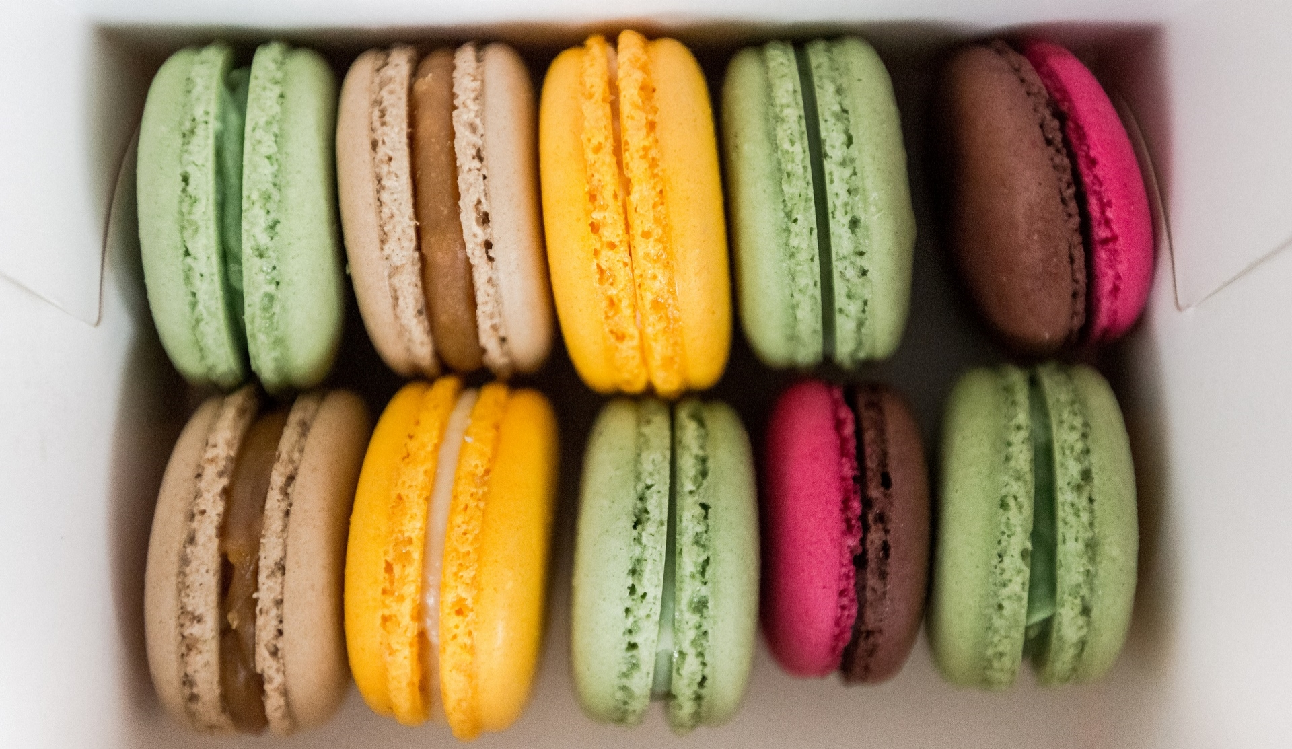
What source code/tutorials did you find?
Plan:Eat (meal planner)
Meal_app
Building a Food truck app in Flask
Notes:
There was a lot of resources that we found in GitHub and numerous amounts of YouTube videos to formulate the python code. Such as Plan: Eat meal planner that is a code curated to allow users to schedule meals for a week/month/year with recipes that user had already created or entered. Meal_App that also has the same design as Plan Eat where it catalogs frequent meals entered so that you can search meals by ingredients. And lastly a YouTube video Building a Food truck app in Flask. Where we are show how to create a food tracker app.

Slide 4

How did your project develop?
In Correspondence to the Spirits:
Create Licenses and Descriptions
Use code bank to create finish code
Run it multiple times
Notes:
We first looked at Different meal related apps created in python to first see which code will best help us create one to fulfill the app desire to create meals based on delicious meals out there in the world In correspondence to the Spirits hat we needed to follow the license and read me were first laid out with addition to extra template helps we could use. Once we found a good bank of codes to use and enough videos to make the code of the app we later created the code and ran it multiple time to test it out to make sure it is working how we want the app to run.

Slide 5
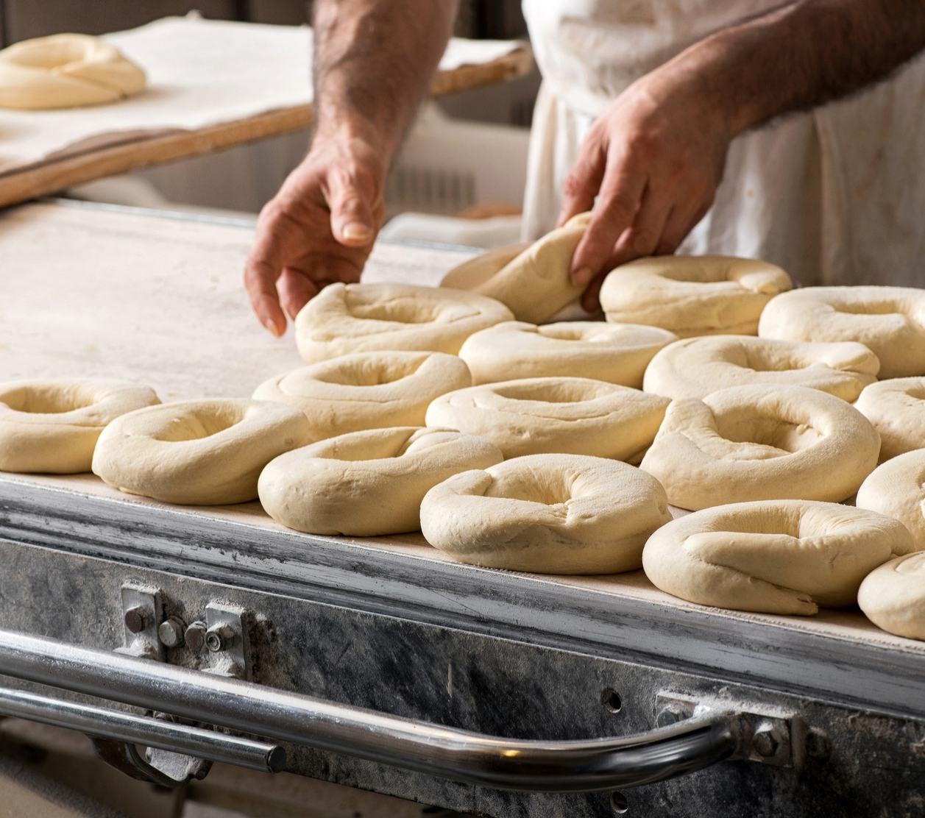
What surprised you? How did the scope change? Why?
The amount of resources
Changed the direction of we looked at coding for this app
Foodies App has many characteristics that are used which becomes intimidating when creating a code for it.
Notes:
I think what helped us the most is the amount of research used and tools used to create the code.
What surprised us the most was the number of other users that had the same idea that had already mapped out how an app like ours can take full form.
Finding this out change the scope of the project tremendously as it made the vison seem clearer. In regard to how the code is written and indention and what certain short cuts in python we can use.
I believe this surprised us the most because the coding of the app seamed like it should be harder to create with all its specialty characteristics that we a using to make out app different the other like pinpoint one delcious meal with only a few ingredients

Slide 6
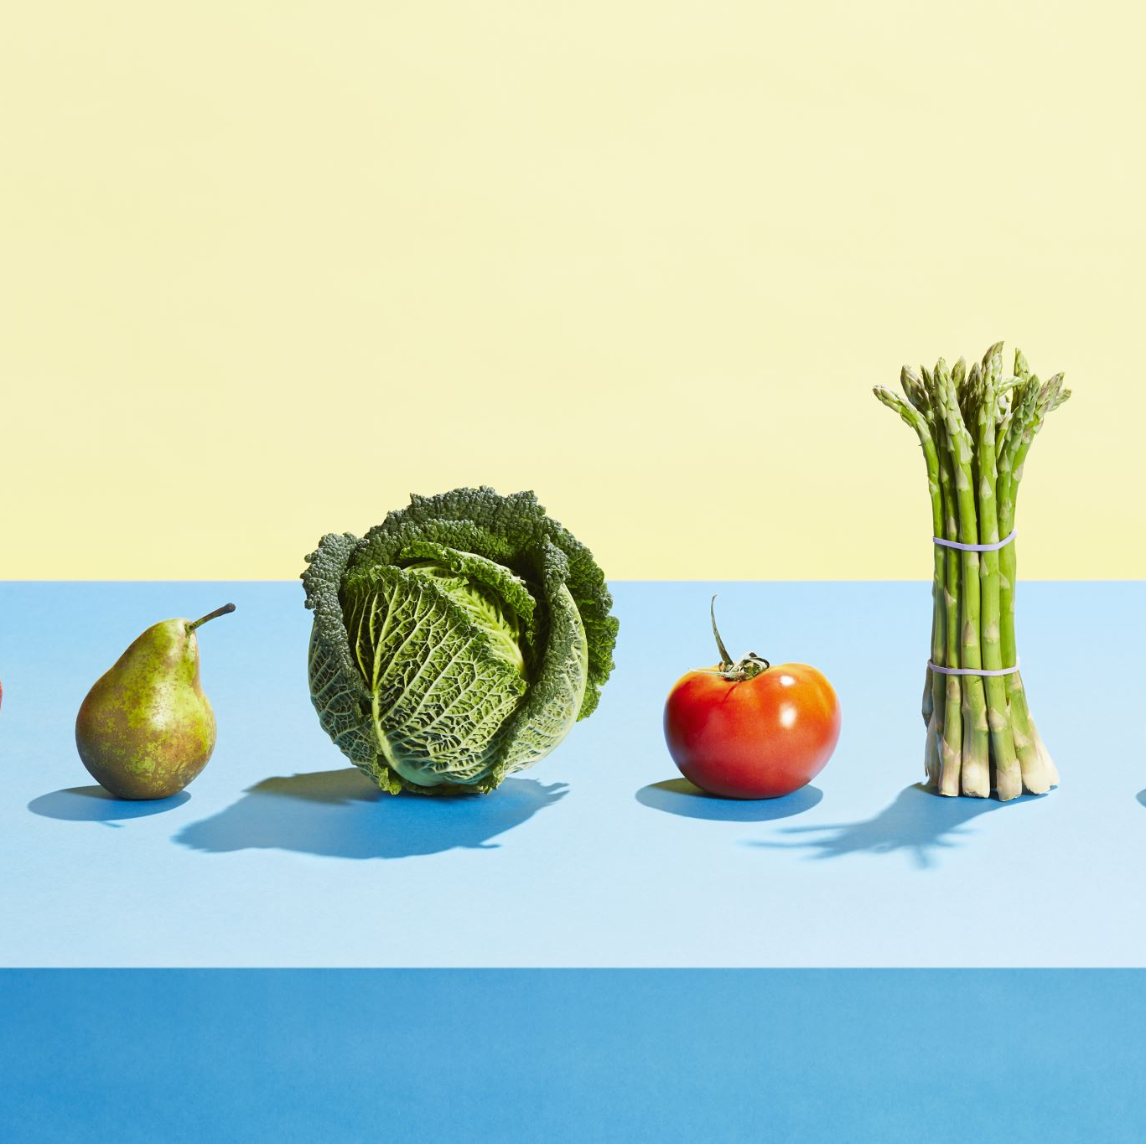
What roadblocks did you face?
Search Engine Issues
Finding the Correct code to use that is needed for the app
How did you overcome them?
Using other codes that did not include food
Classmates
Notes:
What roadblocks that arise during coding are finding the correct code to create certain parts in the code that other helpful codes didn’t provide that are needed just for foodies app. Such as a search engine that will be used for multiple inputs in the ingredients that can find one meal that best fits with how we wanted the app to run. Overcoming these roadblock included finding other apps that used exactly what we wanted in the code for the app even if the help had nothing to do with food at all. Also using other resources like our peers that may have had experience with a certain part of the code we need that was totally unrelated to their project but they have used in the past before.

Slide 7
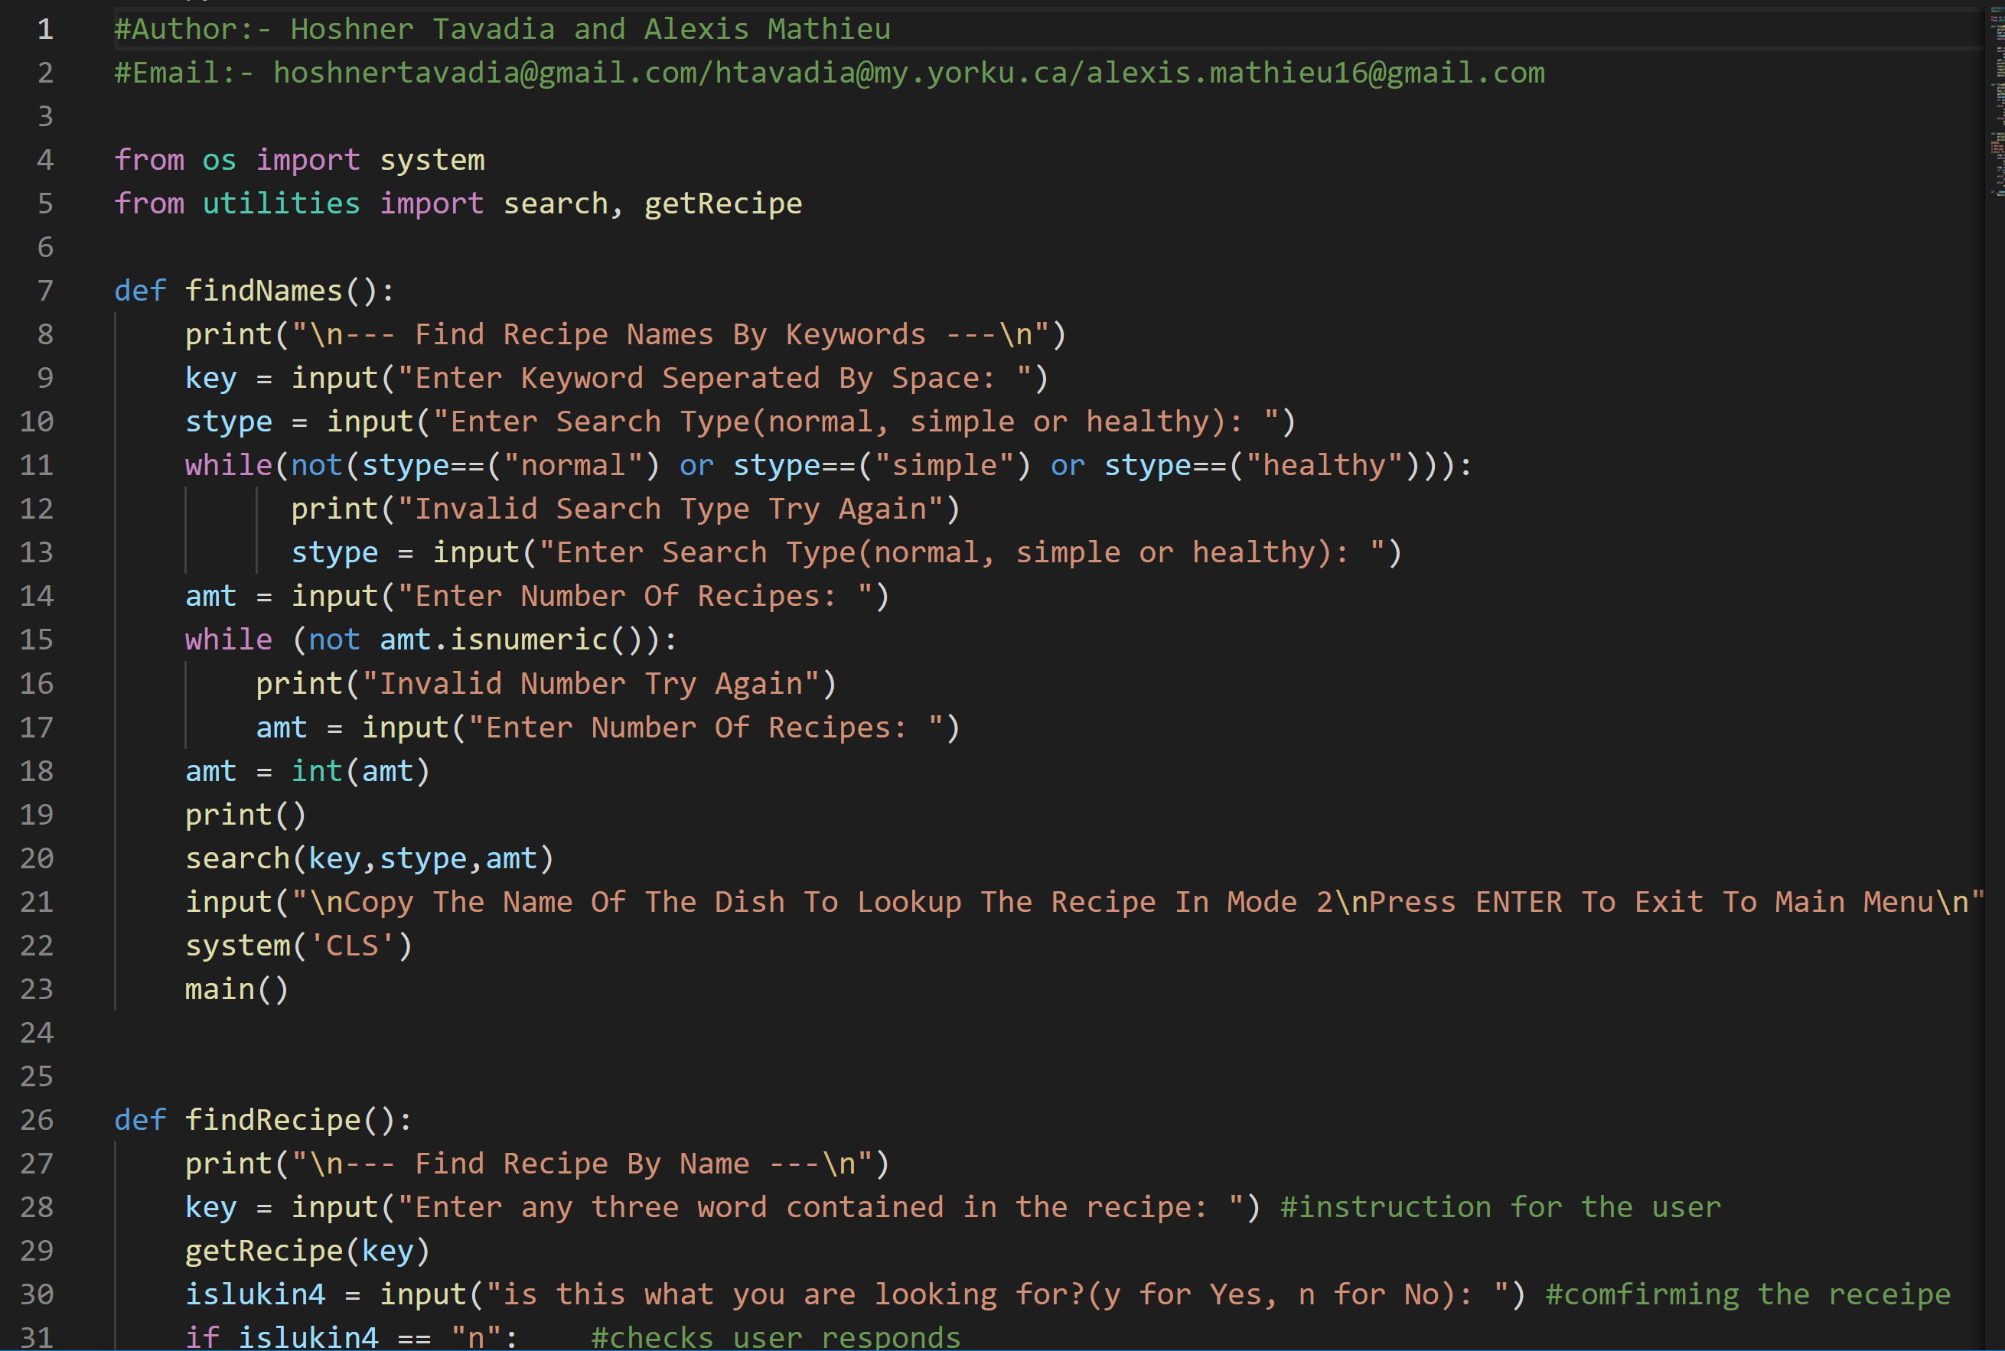
show the code and changes you made to fix it.
Notes:
Some Changes in the app that weren’t screen shotted before are originally Incorrect indention, wrong class def orders for the app. Specifying wrong parameters for expectations for invalid inputs from the user and lastly small; syntax errors

Slide 8
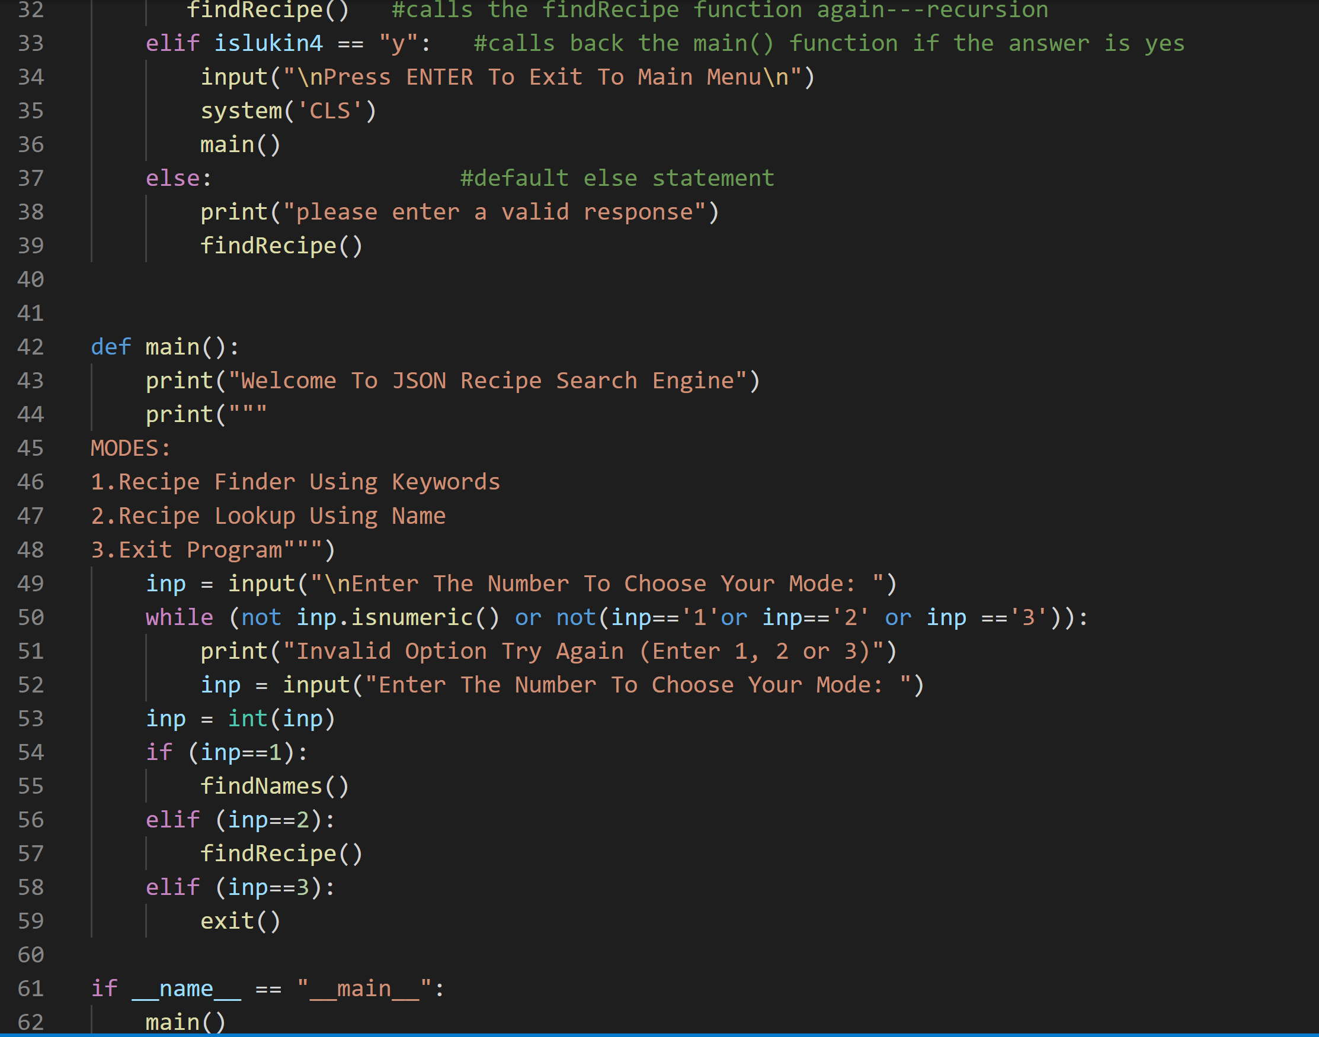
show the code and changes you made to fix it.
Notes:
The rest of the code located here that also includes all the changes previously stated to change for the code.

Slide 9
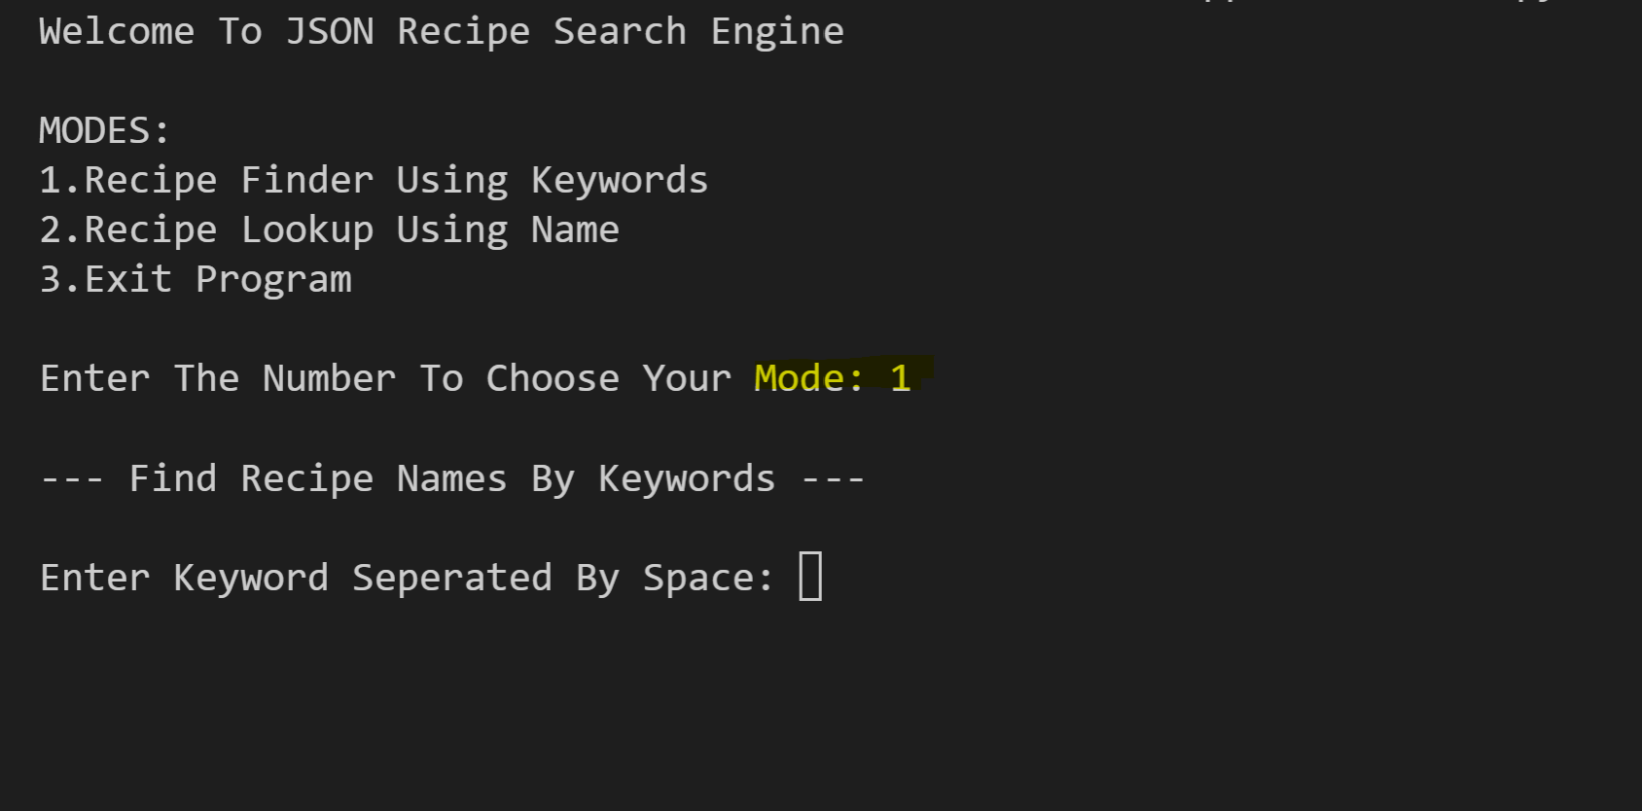
Does it run?
Notes:
This is the Home Page of the app where you are asked to choose three options 1. Recipe Finder Using Key words, 2 Recipe lookup using name or 3.Exit the program.
For showing purposes I chose 1.

Slide 10
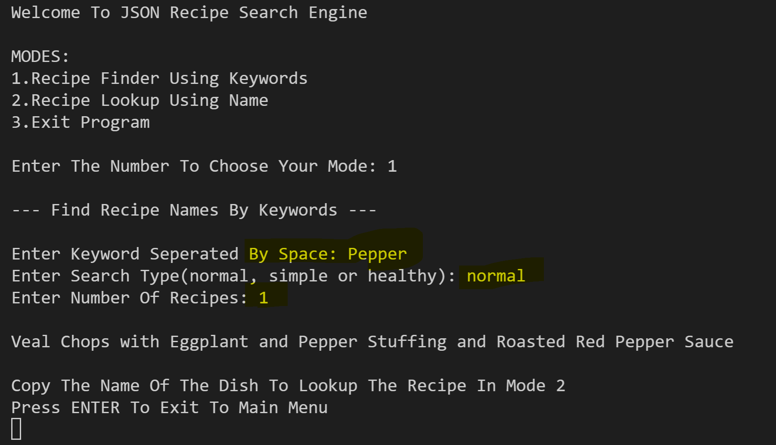
Running….
Notes:
Entered Keyword pepper where you are then prompted to enter what search type you are wanting. For the sake of the example, I put normal and asked the system to provide just 1 recipe where I then given
Veal Chops with Eggplant and Pepper Stuffing and Roasted Red Pepper Sauce as a meal.
User is then prompted to return back the home page to enter the name of the meal and option 2 of the choices on the homepage

Slide 11
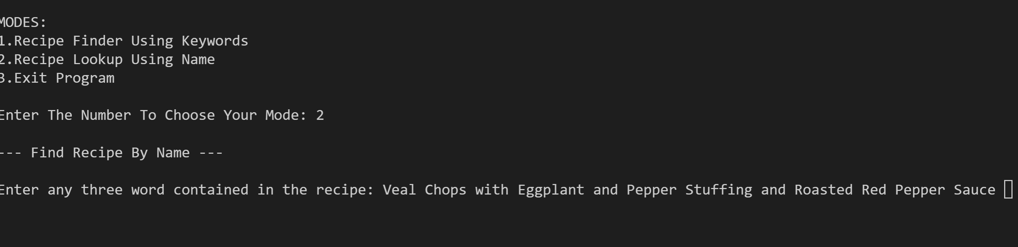
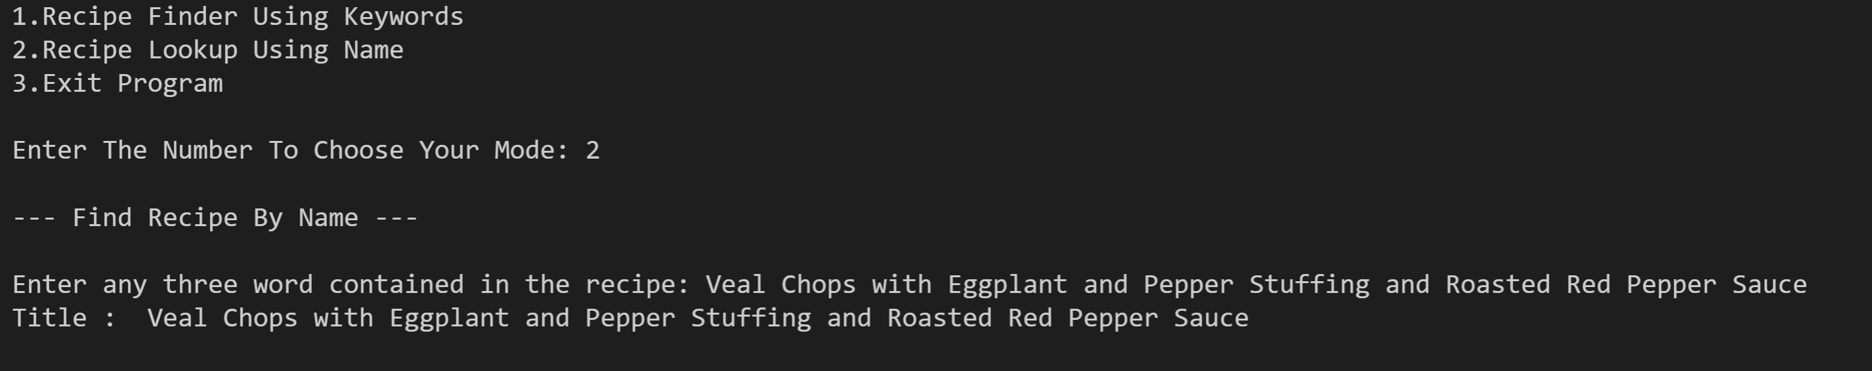
Running…..
Notes:
Here is the app screenshot of going back to the home page and choosing option 2 and pasting the name of the given meal option.

Slide 12
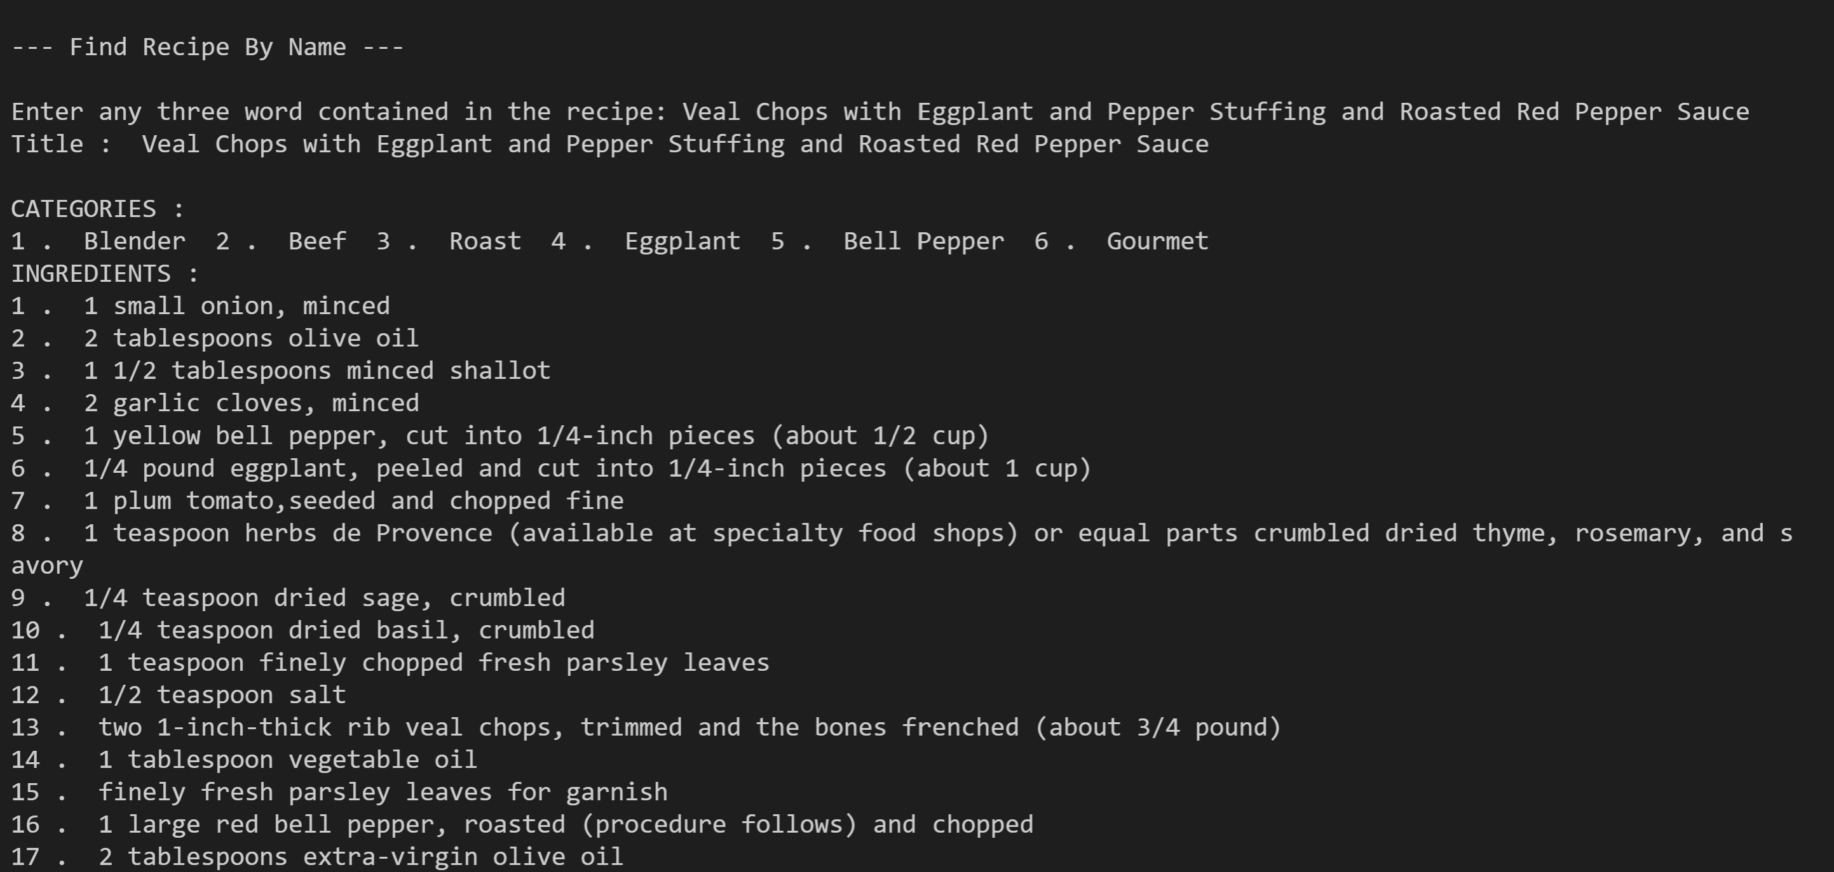
Finished Product
Notes:
The finished product of the meal ingredients and instructions on how to cook it.

Slide 13
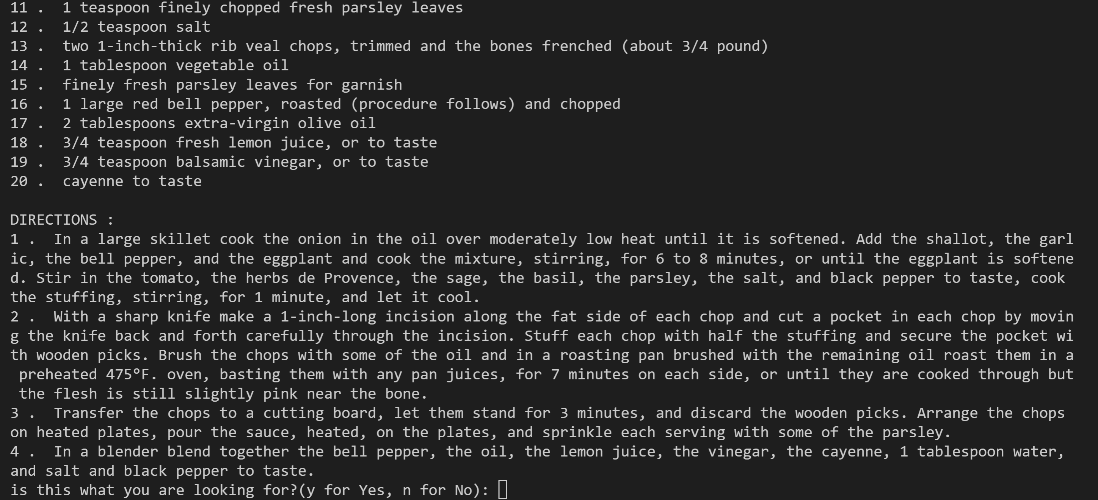
Finished Product
Notes:
Part two of the results given for the app.

Slide 14

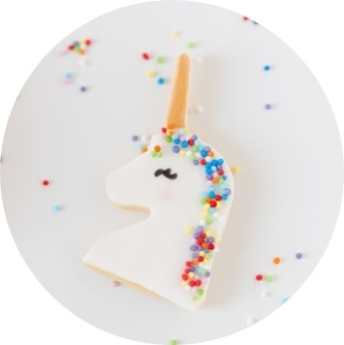

Adeyinka Adeogun and Alexis Mathieu
Foodies App….
Saves time
Produce delicious meals
Runs so smooth that is makes the calories worth it.
Notes:
This app saves a lot of time with just one key word/ingredients located in the house you can get a full meal that will save you so much time of constant searching that can overwhelm the user with option that they later no longer want to eat what is cooked in the house and go outside for food.

Slide 15
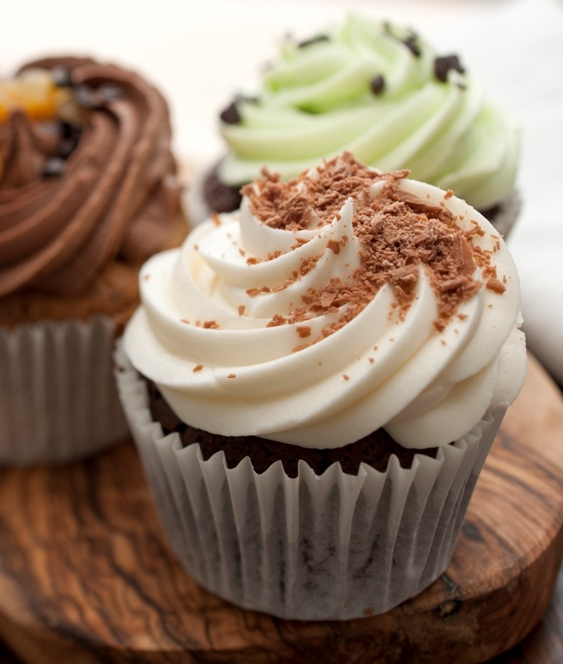
THANK YOU
Adeyinka Adeogun
and
Alexis Mathieu
Notes:
Thank you for opportunity to show you our app.

